Slide 1


Faculty Development Program
On
ARTIFICIAL INTELLIGENCE & MACHINE LEARNING
5th – 9th February
Introduction to Artificial Intelligence
By
Dr. Sibarama Panigrahi
Senior Member, IEEE
Assistant Professor, Department of Computer Sc. & Engineering
National Institute of Technology, Rourkela, Odisha, 769008, India
Mobile No.: +91-7377302566
Email: panigrahis[at]nitrkl[dot]ac[dot]in
panigrahi[dot]sibarama[at]gmail[dot]com

Slide 2
Outlines
Motivation
Introduction to Artificial Intelligence
Foundations of Artificial Intelligence
History of Artificial Intelligence
Agents and Environments
Intelligent Agent
The Concept of Rationality
Nature of Environments
Structure of Agents
Motivation for AI

Slide 3
Motivation to Learn Artificial Intelligence (AI)
AI is Everywhere Now
Motivation in Research - Science Direct

Slide 4
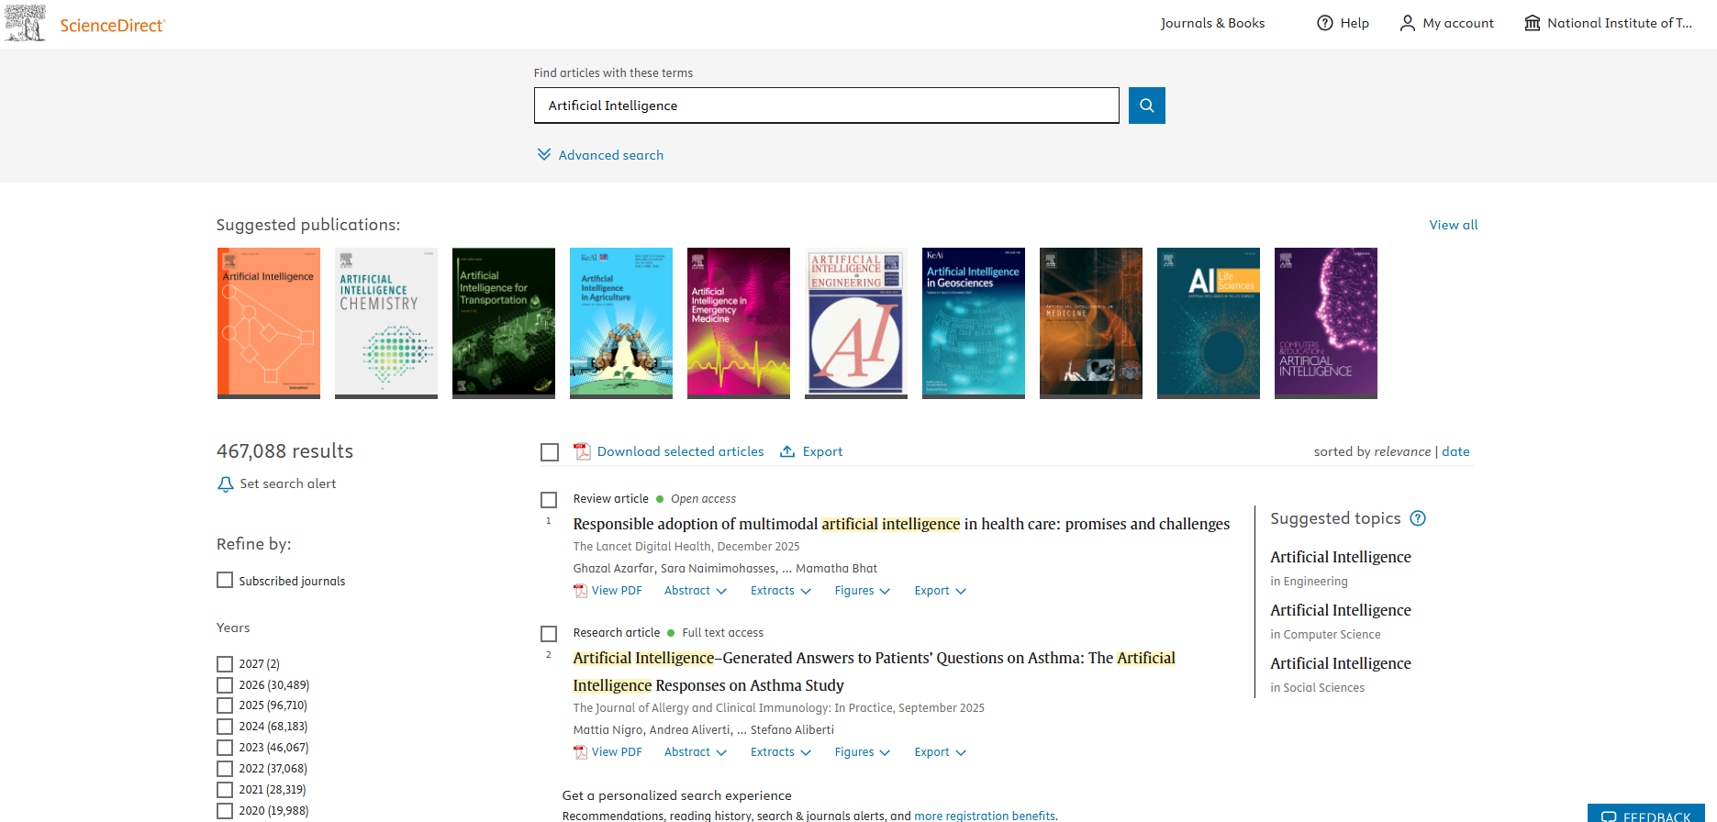

Motivation to Learn Artificial Intelligence (AI) – In Research
Motivation in Research - IEEE

Slide 5
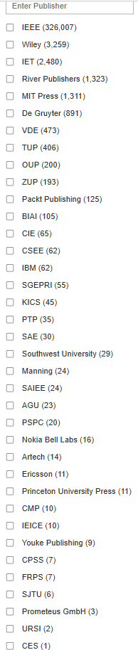

Motivation to Learn Artificial Intelligence (AI) – In Research
Motivation for AI in Emerging Technologies

Slide 6
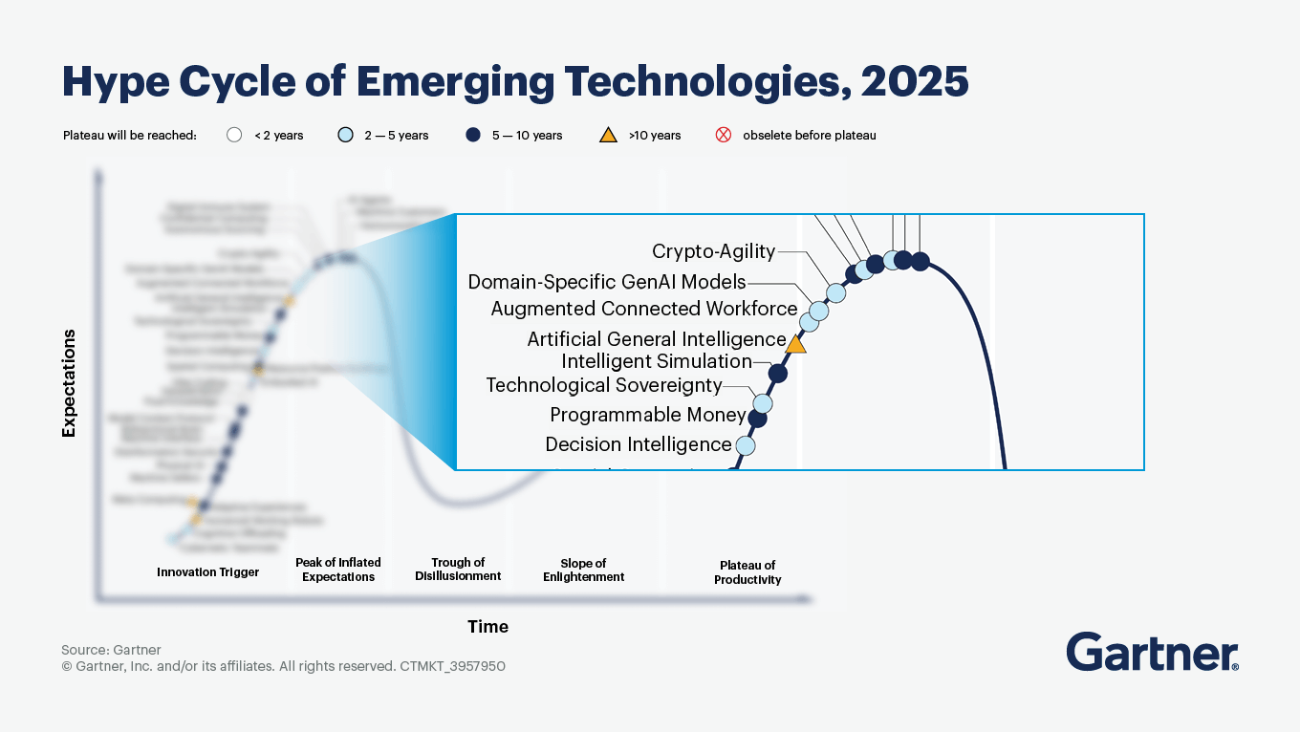
Motivation to Learn Artificial Intelligence (AI) – Emerging Technologies
Motivation for AI- Top Strategic Technology Trends

Slide 7
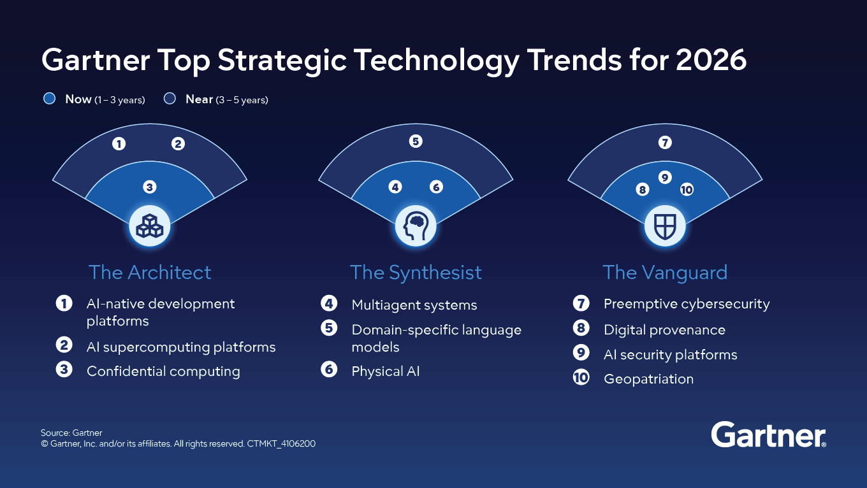
Motivation to Learn Artificial Intelligence (AI) – Technology Trends
Motivation for AI- Tech Giants

Slide 8

Motivation to Learn Artificial Intelligence (AI) [List of Few Tech Giants]
Source: https://businessabc.net/global-ai-investments-by-tech-giants-trends-challenges-and-future-prospects
Knowledge vs Intelligence

Slide 9

Knowledge vs Intelligence
Intelligence

Slide 10
Intelligent machines, or what machines can do
Philosophers have been trying for over 2000 years to understand and resolve two Big Questions of the Universe:
How does a human mind work, and can non-humans have minds?
(These questions are still not fully answered.)
Intelligence is their ability to understand and learn things.
Learning = Improving with experience at some task
Improve over task T
with respect to performance measure P
based on experience E
Can Machines Think? -- Turing

Slide 11
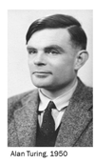
Can Machines Think?
One of the most significant papers on machine intelligence, “Computing Machinery and Intelligence”, was written by the British mathematician Alan Turing in 1950 [1].
However, it still stands up well under the test of time, and the Turing’s approach remains universal.
He asked:
Is there thought without experience?
Is there a mind without communication?
Is there language without living?
Is there intelligence without life?
All these questions, as you can see, are just variations on the fundamental question of artificial intelligence: Can machines think?
[1] Turing, A. (1950). Computing machinery and intelligence. Mind, 59, 433-460.
Turing’s Imitation Game- Phase-1

Slide 12
Turing Imitation Game: Phase 1
In the first phase,
the interrogator,
a man and
a woman
are each placed in separate rooms.
The interrogator’s objective is to work out who the man is and who the woman is by questioning them.
The man should attempt to deceive the interrogator that he is the woman, while the woman has to convince the interrogator that she is the woman.
Turing’s Imitation Game- Phase-II

Slide 13
Turing Imitation Game: Phase 2
In the second phase of the game, the man is replaced by a computer programmed to deceive the interrogator as the man did.
It would even be programmed to make mistakes and provide fuzzy answers in the way a human would.
If the computer can fool the interrogator as often as the man did, we may say this computer has passed the intelligent behaviour test.
What is Artificial Intelligence?

Slide 14
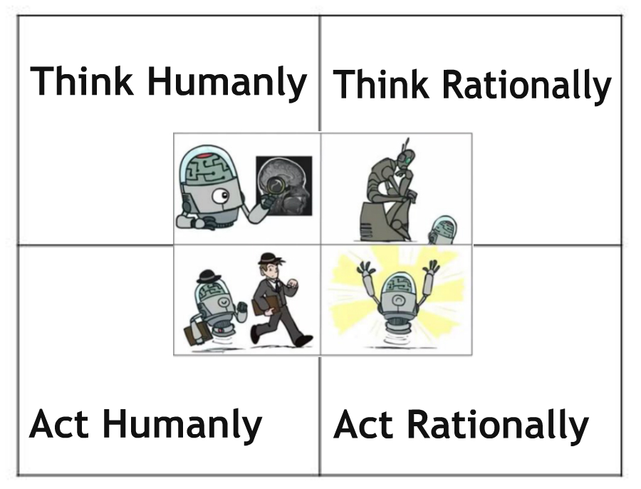
What is Artificial Intelligence (AI)?
Acting humanly: The Turing Test approach
Following capabilities are needed:
Natural Language Processing
Knowledge Representation
Automated Reasoning
Machine Learning
Total Turing Test requires following additional capabilities:
Computer Vision
Robotics
What is Artificial Intelligence?-Think Humanly

Slide 15
What is Artificial Intelligence (AI)?
Thinking humanly: The cognitive modeling approach
Cognitive science brings together
Computer models from AI
and Experimental techniques from psychology to construct precise and testable
theories of the human mind.
What is Artificial Intelligence? – Think Rationally

Slide 16
What is Artificial Intelligence (AI)?
Thinking rationally: The “laws of thought” approach
Using the Field of LOGIC
What is Artificial Intelligence? – Act Rationally

Slide 17
What is Artificial Intelligence (AI)?
Acting rationally: The rational agent approach
An agent is just something that acts (agent comes from the Latin agere, to do).
A rational agent is one that acts so as to achieve the best outcome or, when there is uncertainty, the best expected outcome.
Defining AI

Slide 18
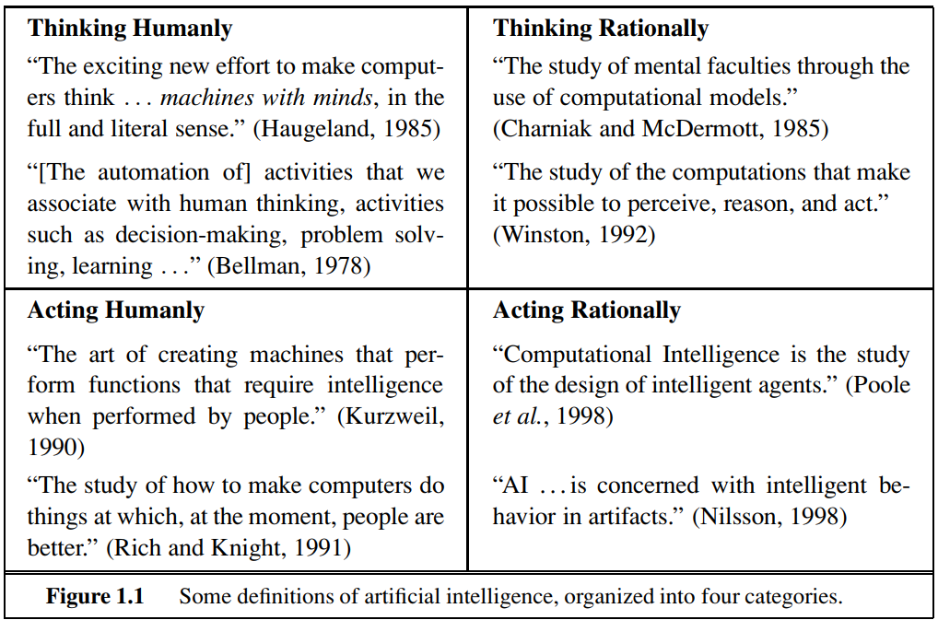
What is Artificial Intelligence (AI)?
Source: Stuart Russell, Peter Norvig, Artificial Intelligence – A Modern Approach, 3rd Edition, Pearson Education, 2009.
Some Other Popular Definitions

Slide 19
What is Artificial Intelligence (AI)? – Some Other Popular Definitions
The simulation of human intelligence on a machine, so as to make the machine efficient to identify and use the right piece of “Knowledge” at a given step of solving a problem.
AI as a subject dealing with computational models that can think and act rationally.
A system capable of planning and executing the right task at the right time is generally called rational.
A system can act rationally only after acquiring adequate knowledge from the real world
Foundations of AI

Slide 20
Foundations of Artificial Intelligence
Foundations
of AI
Philosophy
Mathematics
Economics
Neuroscience
Psychology
Computer Engineering
Linguistics
Control theory and cybernetics
Source: Stuart Russell, Peter Norvig, Artificial Intelligence – A Modern Approach, 3rd Edition, Pearson Education, 2009.
History of AI

Slide 21
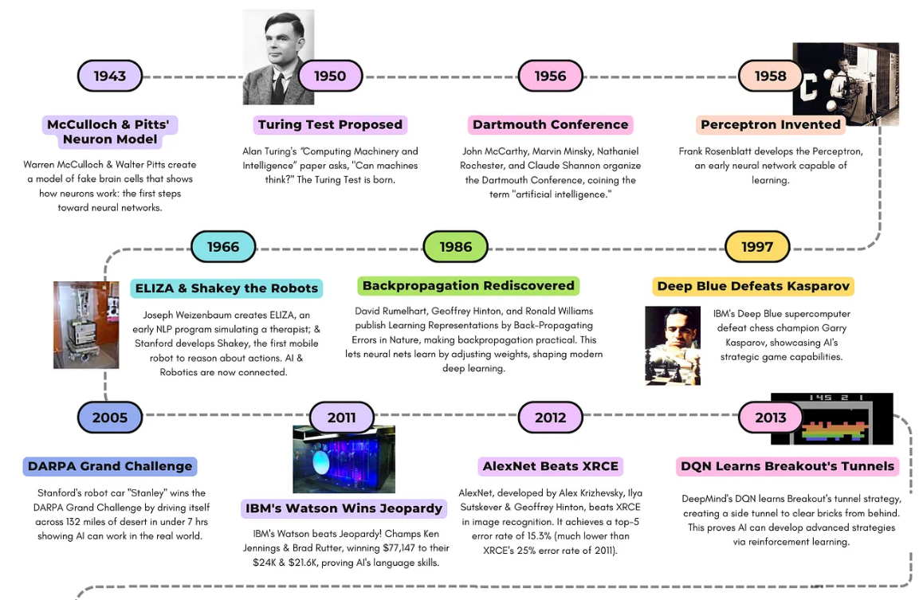
History of Artificial Intelligence [1943-2013]
Source: https://mediaandthemachine.substack.com/p/the-top-20-milestones-in-ai-1943
History of AI

Slide 22
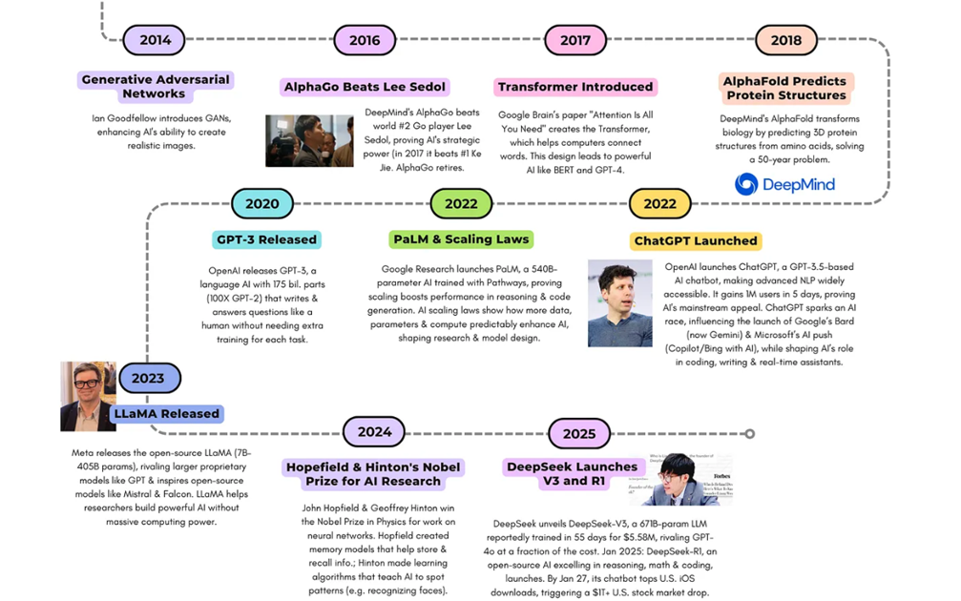
History of Artificial Intelligence [2014-2025]
Nice Video on History of AI:
https://www.youtube.com/watch?v=mSd9nmPM7Vg
Source: https://mediaandthemachine.substack.com/p/the-top-20-milestones-in-ai-1943
Agent

Slide 23


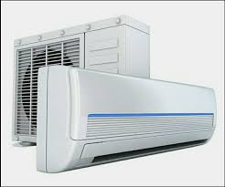
Agents
What is an agent?
An agent is anything that perceiving its environment through sensors and acting upon that environment through actuators
Examples:
Agents Interaction with Environment

Slide 24
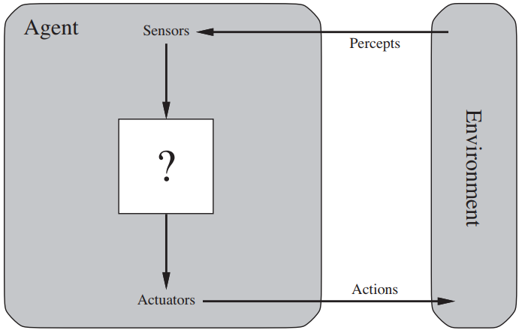
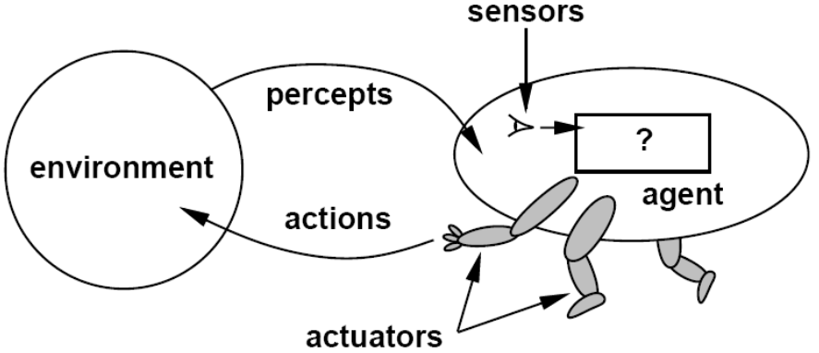
Agents
Fig. 2.1 Agents interact with environments through sensors and actuators. [1]
Percept
Agent’s perceptual inputs at any given instant
Percept sequence
Complete history of everything that the agent has ever perceived.
Agent Function

Slide 25
Agent function & program
Agent’s behavior is mathematically described by
Agent function
A function mapping any given percept sequence to an action
Practically it is described by
An agent program
The real implementation
Fig. 2.1 Agents interact with environments through sensors and actuators. [1]
Example of Agents: Vacuum Cleaner World

Slide 26
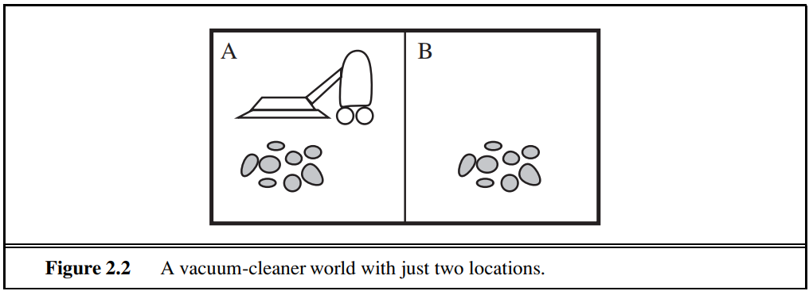
Agents: (e.g., Vacuum-cleaner world)
e.g. Vacuum-cleaner world
Perception: Clean or Dirty? where it is in?
Actions: Move left, Move right, Suck, do nothing
Source: Stuart Russell, Peter Norvig, Artificial Intelligence – A Modern Approach, 3rd Edition, Pearson Education, 2009.
Example Agents Function(Tabular): Vacuum Clean World

Slide 27
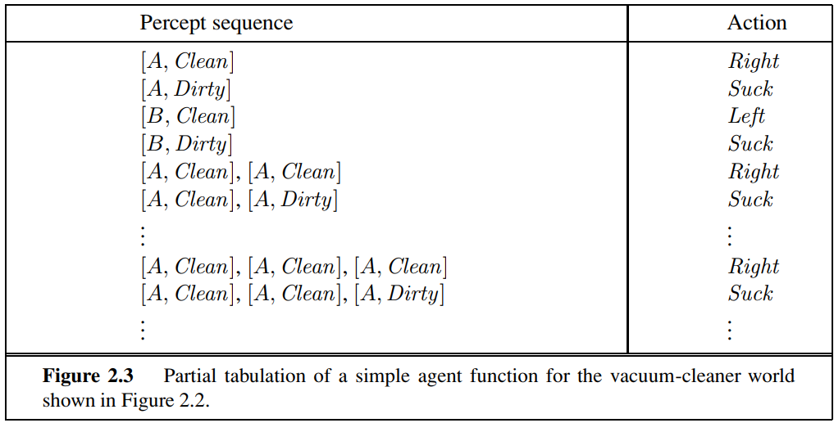
Agents: (e.g., Vacuum-cleaner world)
Source: Stuart Russell, Peter Norvig, Artificial Intelligence – A Modern Approach, 3rd Edition, Pearson Education, 2009.
Example Agents Function(Program: Vacuum Clean World

Slide 28
Agents: (e.g., Vacuum-cleaner world)
The program implements the agent function tabulated
Function Reflex-Vacuum-Agent([location, status]) return an action
If status = Dirty then return Suck
else if location = A then return Right
else if location = B then return left
Rational Agent

Slide 29
Good Behavior: The Concept of Rationality
Rational agent
One that does the right thing.
Every entry in the table for the agent function is correct (rational).
Definition: For each possible percept sequence, a rational agent should select an action that is expected to maximize its performance measure, given the evidence provided by the percept sequence and whatever built-in knowledge the agent has.
What is correct?
The actions that cause the agent to be most successful.
So we need ways to measure success.
Performance Measure

Slide 30
Good Behavior: The Concept of Rationality
Performance measure
An objective function that determines
How the agent does it successfully.
E.g., 90% or 30% ?
An agent, based on its percepts
action sequence: if desirable, it is said to be performing well.
No universal performance measure for all agents
Example of a Rational Agent: Vacuum Cleaner World

Slide 31
Good Behavior: The Concept of Rationality
Example of a rational agent (Vacuum Cleaner World)
Performance measure
Awards one point for each clean square
At each time step, over 10000 time steps
Prior knowledge about the environment
The geography of the environment
Only two squares
The effect of the actions
Actions that can perform:
Left, Right, Suck and NoOp
Percept sequences
Where is the agent?
Whether the location contains dirt?
Under these circumstances, the agent is rational.
Omniscient Agent

Slide 32
Good Behavior: The Concept of Rationality
Omniscient agent
An omniscient agent
Knows the actual outcome of its actions in advance
No other possible outcomes
However, impossible in the real world
An example
crossing a street but died of the fallen cargo door from 33,000ft → irrational?
Rational agents are not omniscient.
Learning

Slide 33
Good Behavior: The Concept of Rationality
Learning
Does a rational agent depend on only current percept?
No, the past percept sequence should also be used
This is called learning
After experiencing an episode, the agent should adjust its behaviors to perform better for the same job next time.
Autonomy

Slide 34
Good Behavior: The Concept of Rationality
Autonomy
If an agent just relies on the prior knowledge of its designer rather than its own percepts, then the agent lacks autonomy
A rational agent should be autonomous- it should learn what it can to compensate for partial or incorrect prior knowledge.
E.g., A clock
No input (percepts)
Run only by its own algorithm (prior knowledge)
No learning, no experience, etc.
Software Agents

Slide 35
Good Behavior: The Concept of Rationality
Software Agents
Sometimes, the environment may not be the real world
E.g., flight simulator, video games, Internet
They are all artificial but very complex environments
Those agents working in these environments are called
Software agent (softbots)
Because all parts of the agent are software
Task Environment

Slide 36
The Nature of Environments
Task environments are the problems.
While the rational agents are the solutions.
Specifying the task environment
PEAS description as fully as possible
Performance
Environment
Actuators
Sensors
In designing an agent, the first step must always be to specify the task environment as fully as possible.
Example of Task Env: Automated Taxi

Slide 37
The Nature of Environments
Example of Task environments through PEAS (Automated Taxi)
Performance measure
How can we judge the automated driver?
Which factors are considered?
getting to the correct destination
minimizing fuel consumption
minimizing the trip time and/or cost
minimizing the violations of traffic laws
maximizing the safety and comfort, etc.
Environment
A taxi must deal with a variety of roads
Traffic lights, other vehicles, pedestrians, stray animals, road works, police cars, etc.
Interact with the customer
Example Continue.. Actuators & Sensors

Slide 38
The Nature of Environments
Example of Task environments through PEAS (Automated Taxi)
Actuators (for outputs)
Control over the accelerator, steering, gear shifting and braking
A display to communicate with the customers
Sensors (for inputs)
Detect other vehicles, road situations
GPS (Global Positioning System) to know where the taxi is
Many more devices are necessary
Example continue.. All at a once

Slide 39
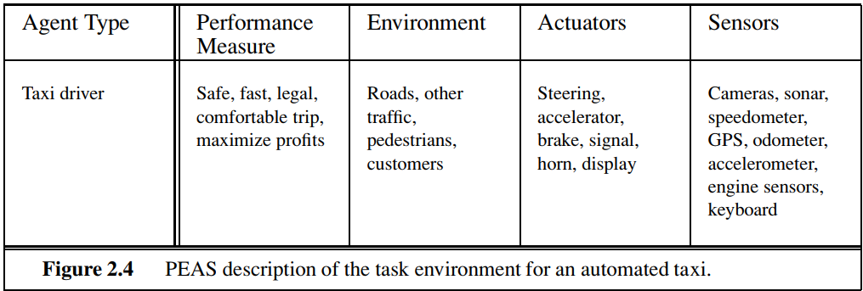
The Nature of Environments
Source: Stuart Russell, Peter Norvig, Artificial Intelligence – A Modern Approach, 3rd Edition, Pearson Education, 2009.
PEAS for Medical Diagnosis System

Slide 40
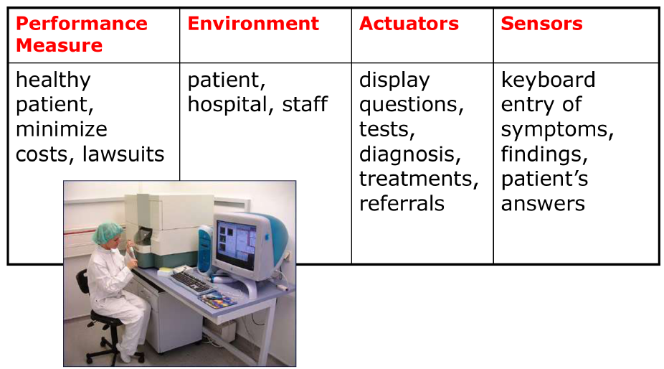
The Nature of Environments
Example of Task environments through PEAS (Medical Diagnosis System)
Example of PEAS: Mushroom Picking Robot

Slide 41
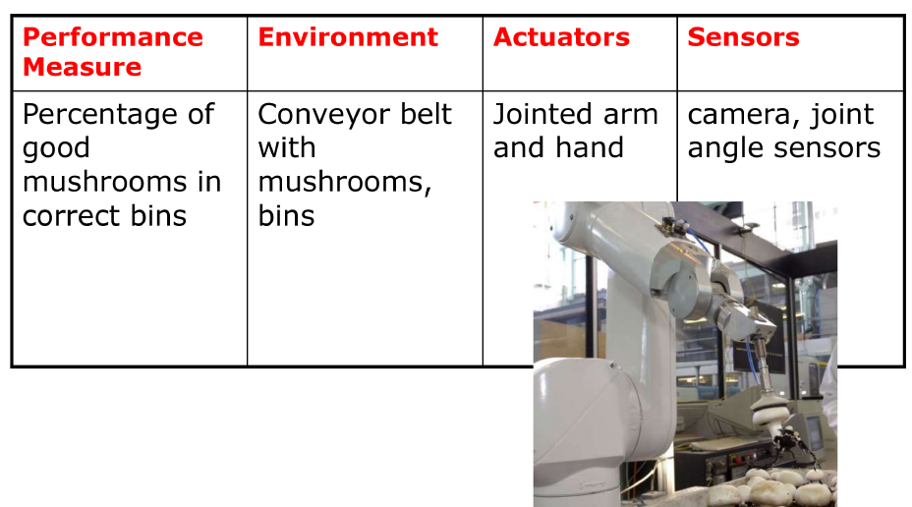
The Nature of Environments
Example of Task environments through PEAS (Mushroom-Picking Robot)
More Examples on Task Environment from Book

Slide 42
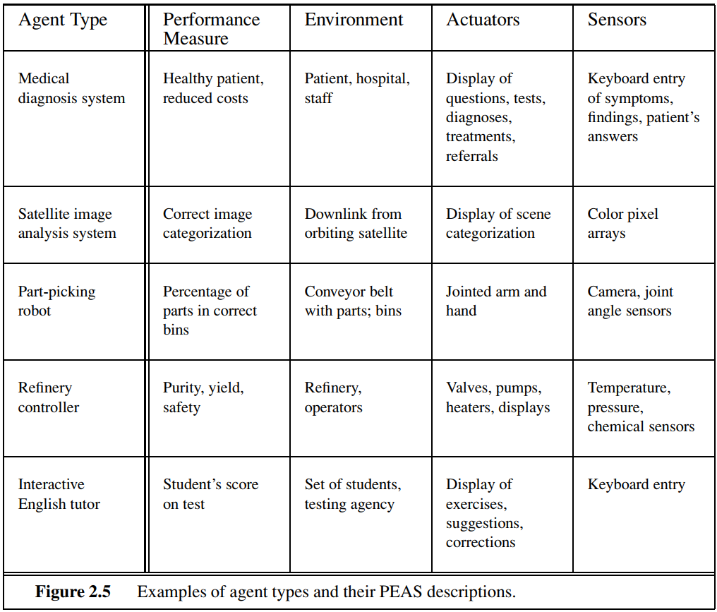
The Nature of Environments
Source: Stuart Russell, Peter Norvig, Artificial Intelligence – A Modern Approach, 3rd Edition, Pearson Education, 2009.
Fully Observable vs Partially Observable Task Env

Slide 43
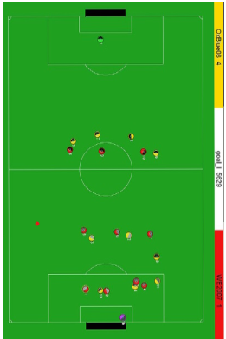
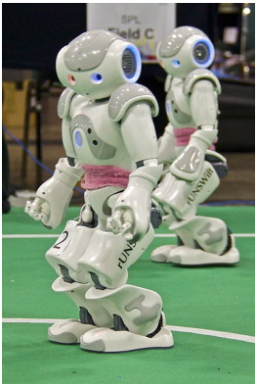
Properties of task environments
Fully Observable If an agent’s sensors give it access to the complete state of the environment at each point in time then the environment is effectively and fully observable. | vs | Partially Observable An environment might be Partially observable because of noisy and inaccurate sensors or because parts of the state are simply missing from the sensor data.
Deterministic vs Stochastic

Slide 44


Properties of task environments
Deterministic If the next state of the environment is completely determined by the current state and the action executed by the agent, then we say the environment is deterministic. | vs | Stochastic If the next state of the environment can’t be determined by the current state and the action executed by the agent, then we say the environment is stochastic.
Episodic VS Sequential

Slide 45
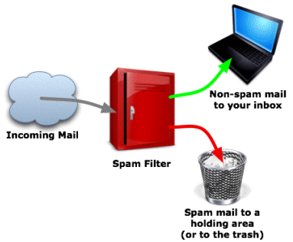
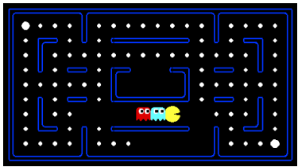
Properties of task environments
Episodic In an episodic task environment, the agent’s experience is divided into atomic episodes. In each episode the agent receives a percept and then performs a single action. Crucially, the next episode does not depend on the actions taken in previous episodes. | vs | Sequential In sequential environments, on the other hand, the current decision could affect all future decisions.
Static vs Dynamic

Slide 46
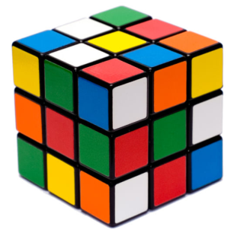
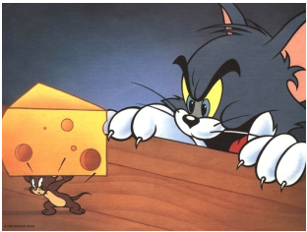
Properties of task environments
Static If the environment does not change while an agent is deliberating, then we say the environment is static for that agent. | vs | Dynamic If the environment can change while an agent is deliberating, then we say the environment is dynamic for that agent.
Discrete vs Continuous

Slide 47
Properties of task environments
Discrete Finite number of distinct states. | vs | Continuous Continuous state and continuous time problem.
Single Agent vs Multi-agent

Slide 48
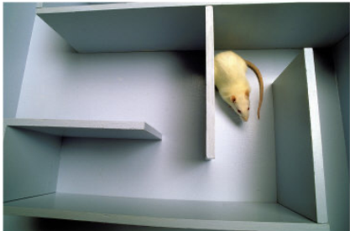
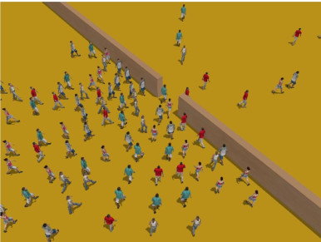
Properties of task environments
Single Agent Single agent involved. | vs | Multiagent Multiple agents involved.
Known vs Unknown

Slide 49
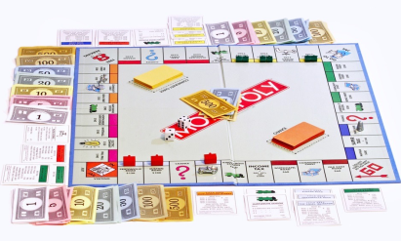
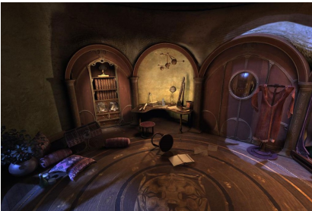
Properties of task environments
Known The environment (transition model and rewards associated with states) known to the agent. | vs | Unknown The entire environment (transition model and rewards associated with states) is not in the agent’s state of knowledge.
Structure of Agent

Slide 50
Structure of agents
Agent = architecture + program
Architecture = some sort of computing device (sensors + actuators)
(Agent) Program = some function that implements the agent mapping = “?”
Agent Program = Job of AI
Agent Programs

Slide 51
Agent Programs
Input for Agent Program
Only the current percept
Input for Agent Function
The entire percept sequence
The agent must remember all of them
Implement the agent program as
A look-up table (agent function)
Skeleton Design of Agent Program

Slide 52
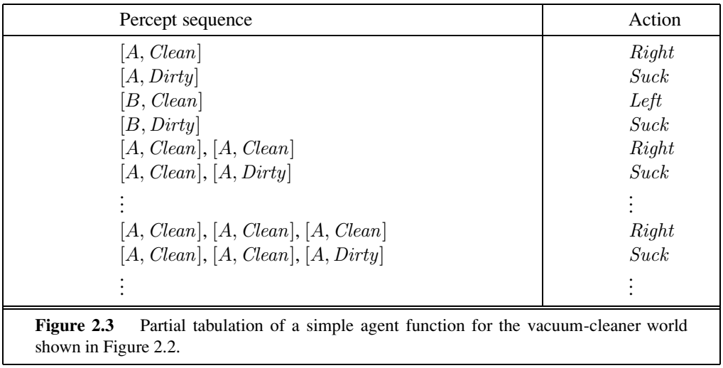
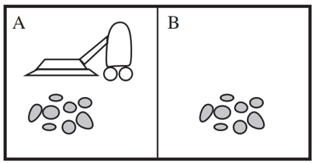
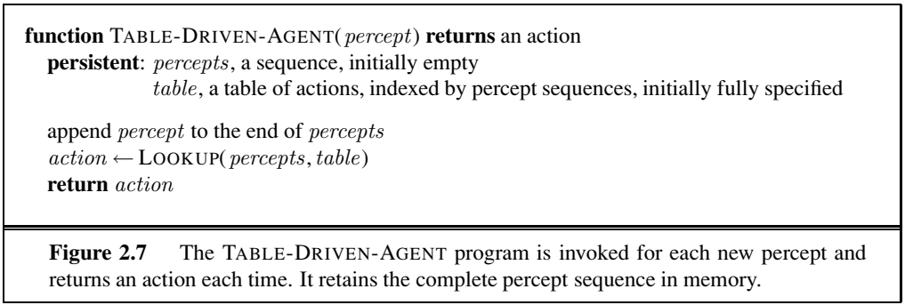
Agent Programs
Skeleton design of an agent program for Vacuum Cleaner World
Problem with Table Driven Agent Programs [Chess]

Slide 53
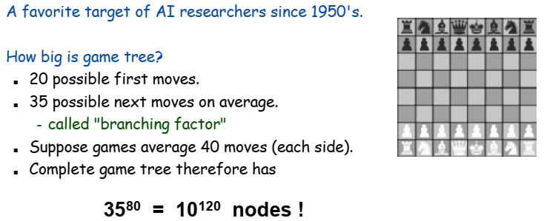
Agent Programs [Problems with Table Driven Agent Programs]
P = the set of possible percepts
T= lifetime of the agent
The total number of percepts it receives
Size of the lookup table
Consider playing chess
P =35, T=80 (40 moves each side)
Will require a table of at least entries= 35⁸⁰ = 10¹²⁰
Problem with Table Driven Agent Programs [Tic-Toc-toe]

Slide 54
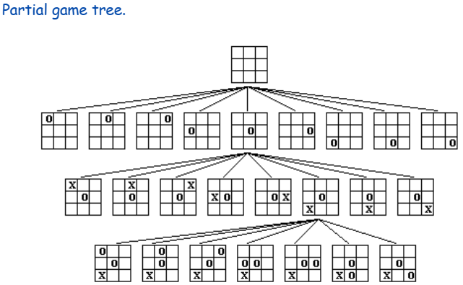
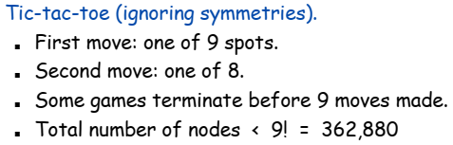
Agent Programs [Problems with Table Driven Agent Programs]
Overcoming it

Slide 55
Agent Programs
Despite of huge size, look up table does what we want.
The key challenge of AI
Find out how to write programs that, to the extent possible, produce rational behavior
From a small amount of code
Rather than a large number of table entries
e.g., a five-line program of Newton’s Method
vs huge tables of square roots, sine, cosine
Types of Agent Programs

Slide 56
Types of Agent Programs
Four types
Simple reflex agents
Model-based reflex agents
Goal-based agents
Utility-based agents
Simple Reflex Agent

Slide 57
Simple Reflex Agents
It uses just condition-action rules
The rules are like the form “if … then …”
Efficient but has a narrow range of applicability.
Because knowledge sometimes cannot be stated explicitly.
Work only
if the environment is fully observable.
Schematic Diagram of Simple Reflex Agent

Slide 58
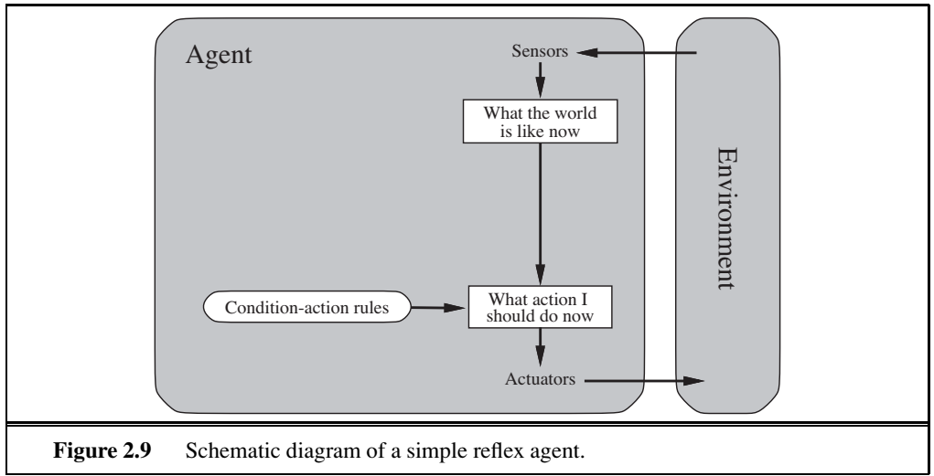
Simple Reflex Agents
Function of a Simple Reflex Agent

Slide 59
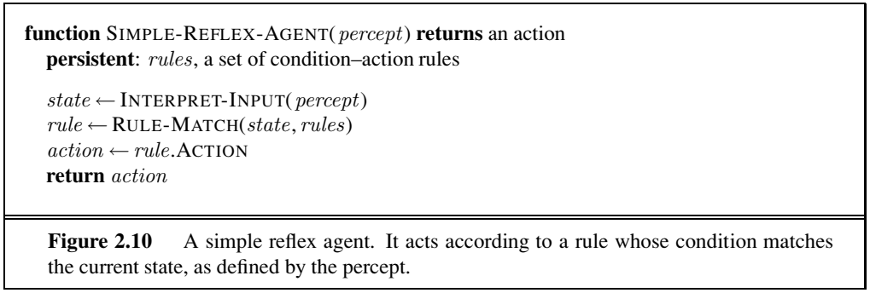
Simple Reflex Agents
Model-based Reflex Agent

Slide 60
Model-based Reflex Agents
For the world that is partially observable
The agent has to keep track of an internal state.
That depends on the percept history
Reflecting some of the unobserved aspects
E.g., driving a car and changing lane
Requiring two types of knowledge
How the world evolves independently of the agent
How the agent’s actions affect the world
Schematic Diagram of Model-based Reflex Agent

Slide 61
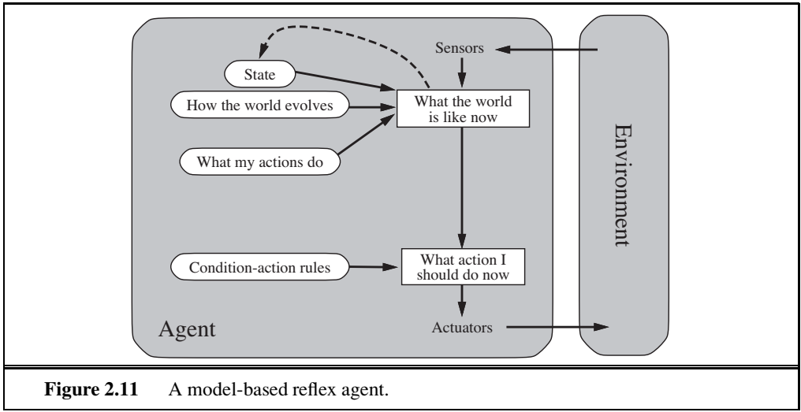
Model-based Reflex Agents
Function of a Model based Reflex Agent

Slide 62
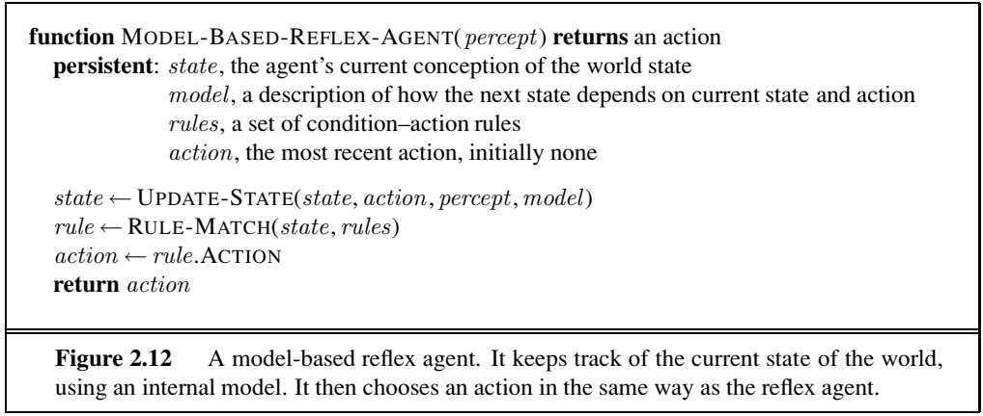
Model-based Reflex Agents
Goal based Agents

Slide 63
Goal-based Agents
Current state of the environment is always not enough.
The goal is another issue to achieve
Judgment of rationality / correctness
Actions chosen → goals, based on
the current state
the current percept
Conclusion
Goal-based agents are less efficient
but more flexible
Agent ← Different goals ← different tasks
Search and planning
two other sub-fields in AI
to find out the action sequences to achieve its goal
Schematic Diagram of Utility based Agents

Slide 64
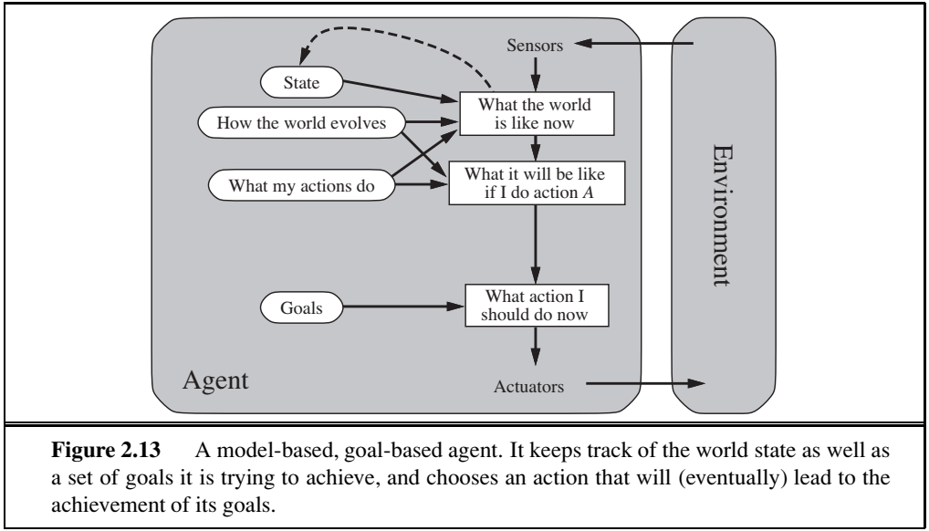
Goal-based Agents
Utility based Agents

Slide 65
Utility-based agents
Goals alone are not enough
to generate high-quality behavior
e.g. meals in Canteen, good or not?
Many action sequences → the goals
some are better and some worse
If goal means success,
then utility means the degree of success (how successful it is)
Utility is therefore a function
that maps a state onto a real number
the degree of success
Schematic Diagram of Utility based Agents

Slide 66
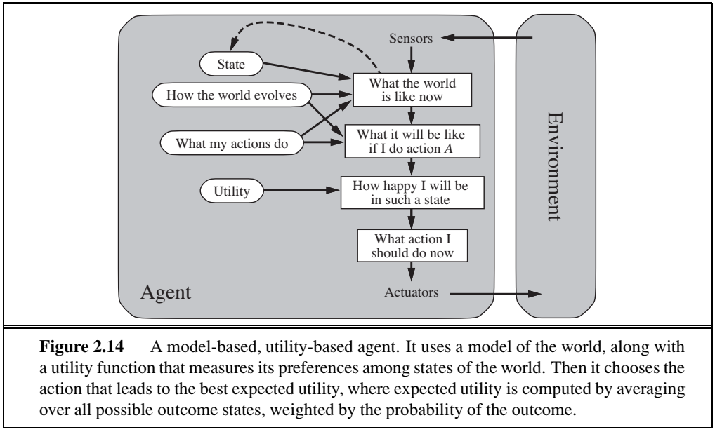
Utility-based Agents
Advantages of Utility based Agents

Slide 67
Utility-based Agents [Advantages]
Utility has several advantages:
When there are conflicting goals,
Only some of the goals but not all can be achieved
utility describes the appropriate trade-off
When there are several goals
None of them are achieved certainly
utility provides a way for the decision-making
Learning Agent

Slide 68
Learning Agents
After an agent is programmed, can it work immediately?
No, it still need teaching
In AI,
Once an agent is done
We teach it by giving it a set of examples
Test it by using another set of examples
We then say the agent learns
A learning agent
Four Conceptual elements of Learning Agent

Slide 69
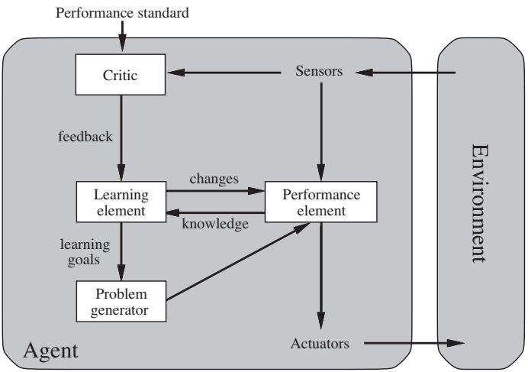
Learning Agents
Four conceptual components
Learning element
Making improvement
Performance element
Selecting external actions
Critic
Tells the Learning element how well the agent is doing with respect to fixed performance standard.
(Feedback from user or examples, good or not?)
Problem generator
Suggest actions that will lead to new and informative experiences.
Essential Reading

Slide 70
References
ESSENTIAL READING
Stuart Russell, Peter Norvig, Artificial Intelligence – A Modern Approach, 3rd Edition, Pearson Education, 2009.
A Course in Machine Learning by Hal Daumé III, Self-Published, http://ciml.info/
SUPPLEMENTARY READING
Elaine Rich and Kevin Knight, Artificial Intelligence, 3rd Edition, McGraw-Hill, 2017.
Nils J. Nilsson, The Quest for Artificial Intelligence, Cambridge University Press. 2009.
Trevor Hastie , Robert Tibshirani , Jerome Friedman, The Elements of Statistical Learning, 2nd Edition, Springer, 2009.
Christopher M. Bishop, and Nasser M. Nasrabadi. Pattern recognition and machine learning. Vol. 4. No. 4., Springer, 2006.
Additional Resources (NPTEL, MIT Video Lectures, Web resources etc.):
UC Berkeley CS188 Intro to AI -- Course Materials http://ai.berkeley.edu/home.html
NPTEL course: An Introduction to Artificial Intelligence By Prof. Mausam | IIT Delhi https://onlinecourses.nptel.ac.in/noc21_cs42/preview

Slide 71

Thank You
For Your Valuable Time.

